Slide 1

ARE LEADERS
BORN OR MADE?
20 April 2017
Karol M. Wasylyshyn, Psy.D.

Slide 2


Slide 3
Leaders are
destined to lead

Slide 4
3 destiny factors:
Experience
Experience
Behavior
.

Slide 5

LEADERSHIP: THE WHAT and the HOW
WHAT
HOW

Slide 6

Emotional Intelligence (EQ):
Core Leadership Factor – on a par with other leadership competencies

Slide 7
Emotional Intelligence:
Four Dimensions
SO SMART®
Self-Observation
Self-Management
Attunement
Relationship Traction

Slide 8

Self-Observation:
The awareness of our emotions --and their effects on others.
Core Ability: Perceiving emotions

Slide 9

Self-Management:
The ability to control emotions, and to channel them as a resource for achieving work and life objectives.
Core Ability: Managing emotions

Slide 10

Attunement:
A genuine focus on others that promotes strong relationships. Empathy for others’ concerns. Tuned into organization culture factors. Affirmation of work well done.
A genuine focus on others’ concerns. Being tuned into organization culture factors.
Core Ability: Using emotions

Slide 11

Relationship Traction:
The capacity to form relationships that are “real” not just transactional. Sufficient emotional understanding to build collaborative teams that deliver results.
Core Ability: Understanding emotions

Slide 12
“No doubt emotional intelligence is more rare than book smarts, but my experience says it is actually more important in the making of a leader. You just can’t ignore it.”
Jack Welch, Wall Street Journal, 1/23/04

Slide 13
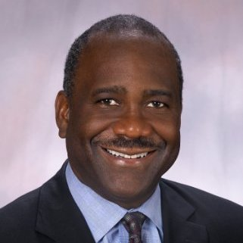
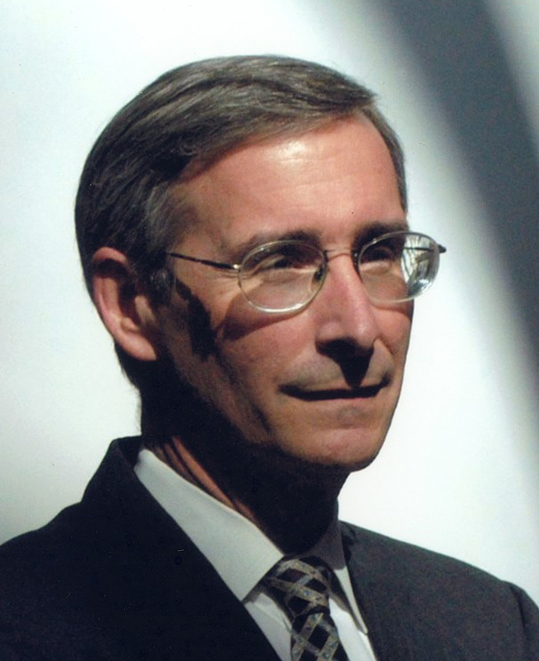
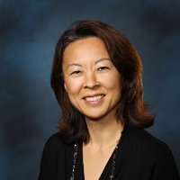
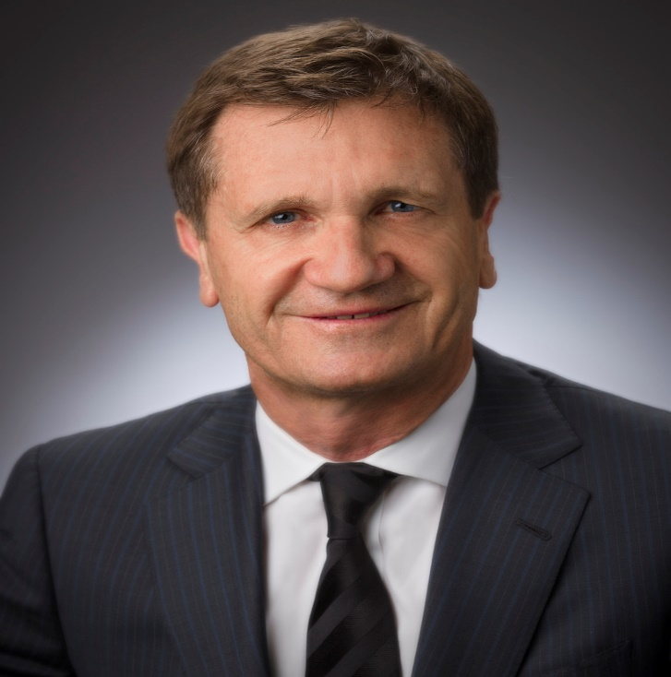
A Midlife Reinvention
The Relentless Champion
The Duality Within
The Recovering Perfectionist

Slide 14
WHY WERE THESE LEADERS DESTINED TO LEAD?
EMOTIONAL INTELLIGENCE
TOTAL BRAIN LEADERSHIP (TBL)
PRODUCTIVE NARCISSISM

Slide 15
TOOLS for EVOLVING YOUR LEADERSHIP
CLARITY
GRIT
EQi - BarOn Emotional Quotient Inventory (Multi-Health Systems, Inc. - www.mhs.com)
VISUAL LEADERSHIP METAPHOR (VLM)

Slide 17
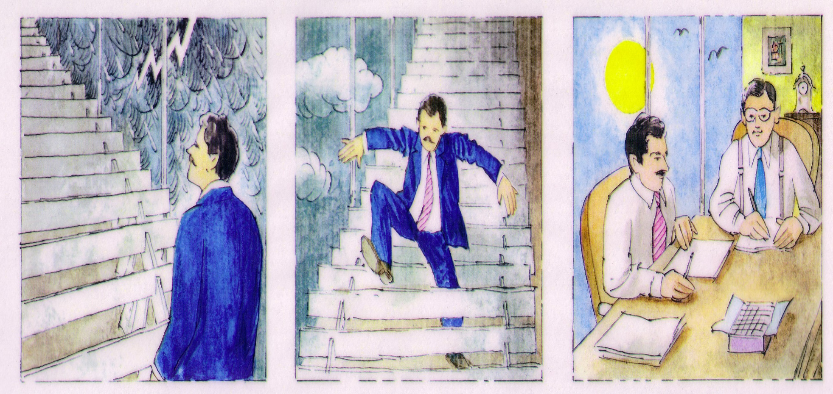

Slide 19
Questions

Slide 20
CONTACT INFORMATION s
Karol M. Wasylyshyn, Psy.D.
(WA-SA-LISH-IN)
Email: kwasylyshyn@erols.com
Phone: 1 215 627 0855
Website: www.karolwasylyshyn.com

