Slide 1
Karol M. Wasylyshyn, Psy.D.
November 18, 2016
Philadelphia, PA
McNulty Leadership Program
at Wharton
Coaching at the Top:
The Trusted Leadership Advisor (TLA) Role

Slide 2
TRUSTED LEADERSHIP ADVISORS (TLAs) FOR SENIOR EXECUTIVES --
REALLY?!
“My CEO peers say that if we don’t have someone like you, we just don’t have all the resources we need to do these jobs.”
-- Ellen J. Kullman
Former Chairman and CEO, Dupont

Slide 3
TRUSTED LEADERSHIP ADVISOR (TLA)
Definition:
An executive coach who has completed a successful coaching engagement with a senior business leader, formed a deep bond of trust and mutual respect with this executive, and has been invited by that leader into a longer-term consulting relationship.
The trusted leadership advisor (TLA) integrates all previous knowledge of and experience with the executive to advise on leadership issues and is committed to ensuring the continued effectiveness of this client.

Slide 4
QUESTION:
How does a trusted leadership advisor (TLA) relationship get started?

Slide 5
QUESTION:
How does the TLA ensure the value of this relationship?
• Constructive triangulation
• Gauging continued progress

Slide 6

Visual Leadership Metaphor (VLM)™

Slide 7

Visual Leadership Metaphor (VLM)™

Slide 8

Visual Leadership Metaphor (VLM)™

Slide 9
QUESTION:
How does the trusted leadership advisor (TLA) manage confidentiality?

Slide 10
QUESTION:
How do trusted leadership advisors (TLAs) bill for such engagements?

Slide 11
A Trusted Leadership Advisor (TLA)
Integrated Practice Model

Slide 12
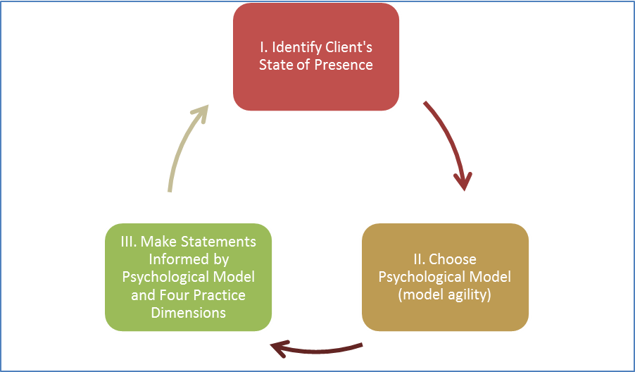
Using the Trusted Leadership Advisor (TLA) Integrated Practice Model

Slide 13
VALUE OF THE TRUSTED LEADERSHIP ADVISOR (TLA)
“People think these CEO jobs are glamorous but they’re not glamorous. These jobs are about people coming and dropping one turd after another outside my door and your job, Karol is to make sure I don’t step in them!”
-- Pierre Brondeau
Chairman and CEO, FMC

Slide 14
??????????????????????????
Q & A
??????????????????????????

Slide 15
CONTACT INFORMATION
Karol M. Wasylyshyn, Psy.D.
(WA-SA-LISH′-IN)
Email: kwasylyshyn@erols.com
Phone: 1 215 627 0855
Website: karolwasylyshyn.com

